Slide 1
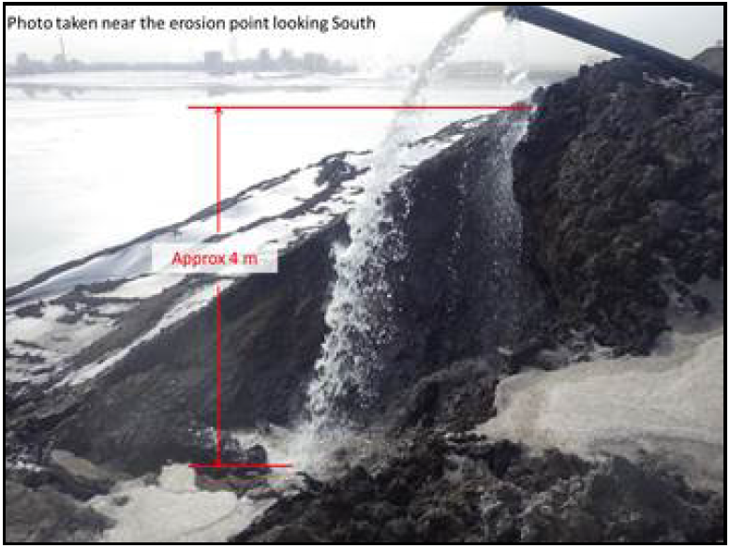
Surface Erosion Damage at Dyke “A” Due to Unprotected Fluid Discharge
Target audience for this alert
Geotechnical Engineering; Tailings Engineering; Mine Operations; Tailings Operations; Pit Dewatering Team; Mining Engineering; Plant Operations.
What happened
Flow from the pit dewatering line was discharged on the upstream face of Tailings Containment Dyke “A” into Pond “A” between 01:00 and 14:00 hrs. This led to an erosion gully on the upstream side of Dyke “A”. The erosion was observed at the discharge location at 12:00 hrs by the Geotechnical Quality Assurance Engineer, at which time the Dewatering Team Lead was notified to shutdown the pump. Water stopped flowing at 14:00 hrs.
Why it happened
Mining dams are typically highly erodible when subject to concentrated surface water flow unless effective erosion protection (such as rip-rap or liner) is in place. In this incident, erosion protection measures were not implemented to control erosion at the discharge location.
Lessons learned
1) Fluid discharge should only be allowed directly into the approved water body or impoundments (e.g. ditches; ponds) – Communication of risks
2) Fluid discharge on structural element of dykes shall only be permitted with adequate surface erosion protection and approval from the Geotechnical Engineer of Record (EOR) or their designate. Dyke structural elements include but not limited to crest, upstream/downstream slope, beach, chimney, toe-berm, seepage barrier/blanket – Communication of risks and safe operating procedures

